Slide 1
Database Concepts Demystified
Joseph Rudolf
API R 2024

Slide 2
Goals and Objectives
Goal:
Get acquainted with the fundamentals of databases including relevant terms and definitions and orient to the environment used in today’s workshop.
Objectives:
Define database systems
List advantages of working with databases
Differentiate fact and dimension tables
Log into Posit Cloud, create a project from a github repository and install packages
Orient to data relevant for workshop
List common clauses in SQL statements

Slide 3
Definitions and Terms

Slide 4
What are Database Systems?
Database: the data, often a series of related tables
+
Database Management System (DBMS): the software for interacting with the database, including writing or extracting data
Notes:
https://en.wikipedia.org/wiki/Database
https://en.wikipedia.org/wiki/Relational_database

Slide 5
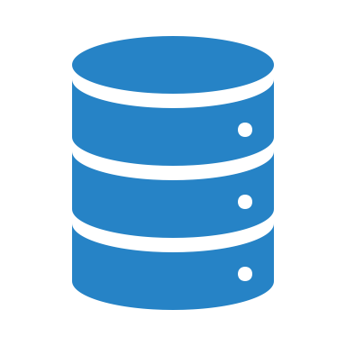
Database System Benefits
Rules for maintaining data integrity
Administrative controls for data access
Capable of storing large amounts of data
Efficient data storage
Notes:
02 – Intro to Databases

Slide 6
Relational Databases
Proposed by Edgar F. Codd at IBM in 1970
Dominant database model to this day
Data organized into entities (tables) with records (rows) and attributes (columns)
Tables normalized to reduce redundancy of stored data
Tables linked to other tables by common keys (shared attributes)
Notes:
Wikipedia

Slide 7
Table Types
Fact
Dimension
Contains the transactional/run the business type data
Goods sold, lab tests performed, etc.
Often the table of interest when performing analyses
May be longer
Contains the descriptive data
Customer contact information, lab location information, etc.
Often required to decode data in fact tables
May be wider
Notes:
Source for this.

Slide 8
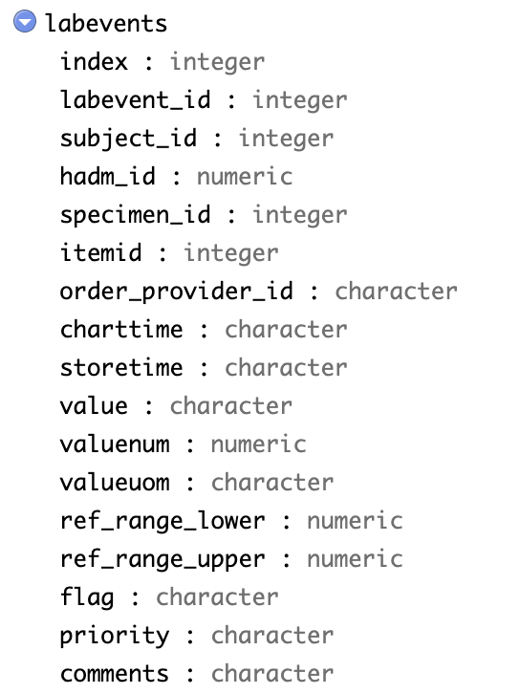
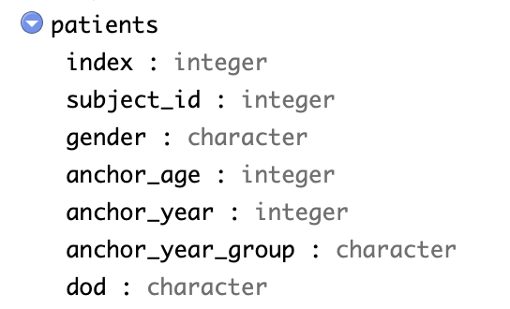
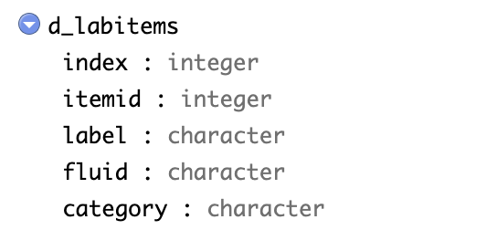
Star Schema
Notes:
Codd
Star Schema

Slide 9
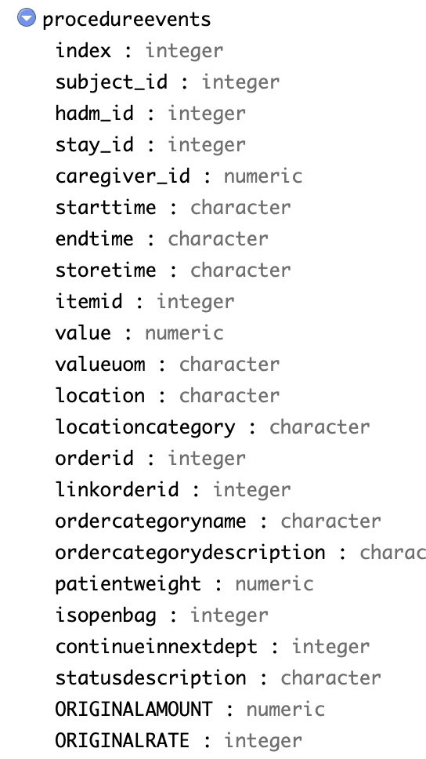
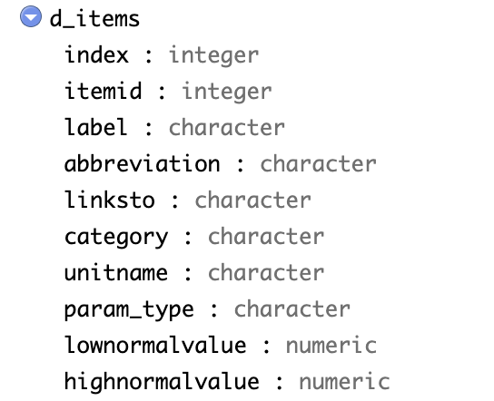
Your Turn #1
Which key would allow these tables to be joined?
Notes:
Bonus: Why not store as one big table?

Slide 10
Logging Into the R Environment

Slide 11

RStudio: On the Web and In Your Home
Posit (RStudio) Cloud
Hosted on a server
(in the cloud)
RStudio Desktop
Installed locally on your computer
Note: Posit Cloud only for this course. Do not upload protected health information to the cloud!

Slide 12
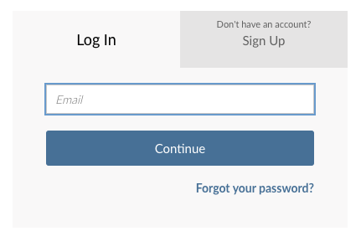
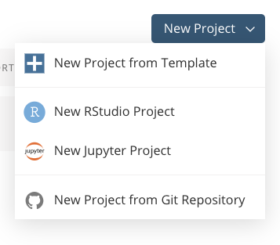
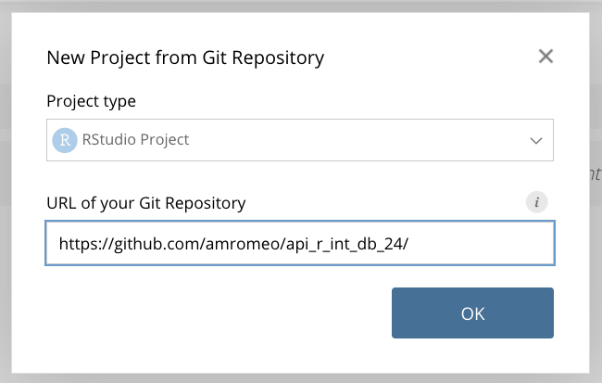
Your Turn #2
Go to https://posit.cloud
1 – Log In
3 – Enter Repository
2 – Create New from Git
Notes:
https://github.com/amromeo/api_r_int_db_24
Now it’s your turn to get logged into Rstudio (Posit) Cloud using the login credentials you created in the course pre-work.

Slide 13
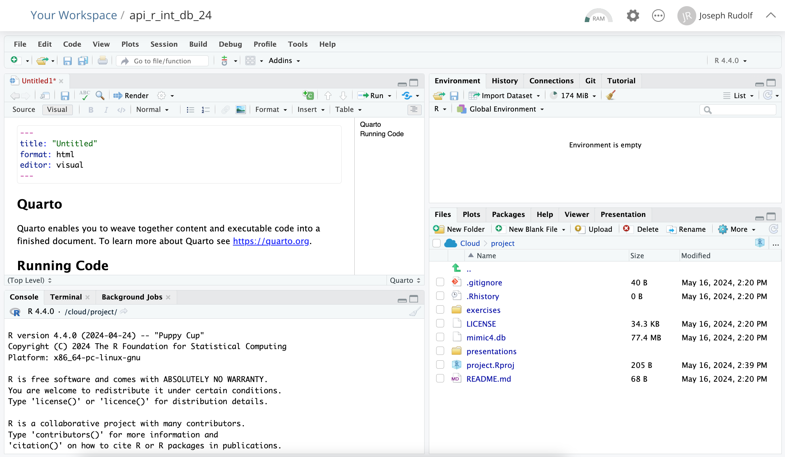
ENVIRONMENT
EDITOR
CONSOLE
MISC
Notes:
Here’s what the RStudio window looks like.
On the top left is the editor. This is where you enter code.
On the top right is the Environment. The environment allows you to look at the data that’s loaded into R. Interacting with data in the environment tab provides some of the functionality you may be familiar with from working in Excel.
The Console is on the bottom left. You can use the console quickly run an individual R command, like install a package. We won’t use the console in this course.
The pane we have labeled “MISC” has a few of tabs. The most important one for today is the “Files” tab which shows the files we’ll be using for the course.

Slide 14
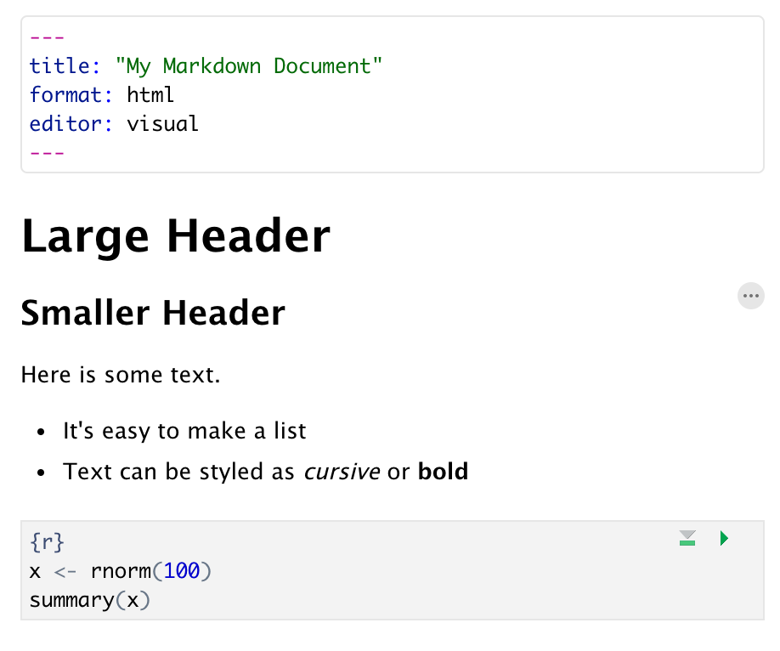
RStudio Terms and Workflow Reminders
Quarto Documents:
Header
Header
Text (w/ formatting)
Code chunk

Slide 15
RStudio Terms and Workflow Reminders
Functions
object
(stores output)
function
(does stuff)
argument
(input)
data_frame <- read_csv(file_name)
assignment operator
(“gets”)

Slide 16
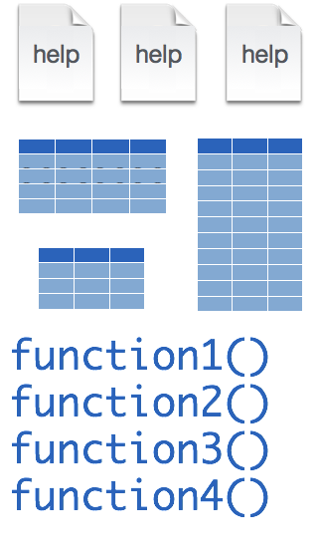
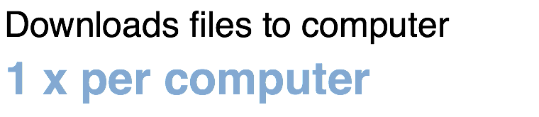
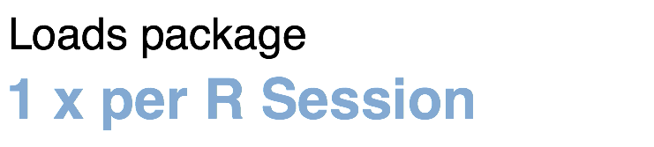
RStudio Terms and Workflow Reminders
Packages:
tidyverse
install.packages("tidyverse")
library("tidyverse")

Slide 17
Your Turn #3
Open 01 – Package Installation.qmd in the exercises folder located in the MISC pane.
Follow the instructions in the Quarto document to install packages needed for this workshop.
Notes:
---
title: "01 - Package Installation"
format: html
---
## Installing Packages
To install packages for this workshop (using the install.packages function) select the run button in the code chunk below.
```{r}
install.packages(c("rmarkdown", "tidyverse", "DBI", "RSQLite", "connections", "fuzzyjoin"))
```

Slide 18
Orienting to the Data

Slide 19
MIMIC Database
“Medical Information Mart for Intensive Care (MIMIC) is a large, freely-available database comprising deidentified health-related data from patients who were admitted to the critical care units of the Beth Israel Deaconess Medical Center.”
Additional information available at:
https://mimic.mit.edu/
Johnson, A.E.W., Bulgarelli, L., Shen, L. et al. MIMIC-IV, a freely accessible electronic health record dataset. Sci Data 10, 1 (2023). https://doi.org/10.1038/s41597-022-01899-x

Slide 20
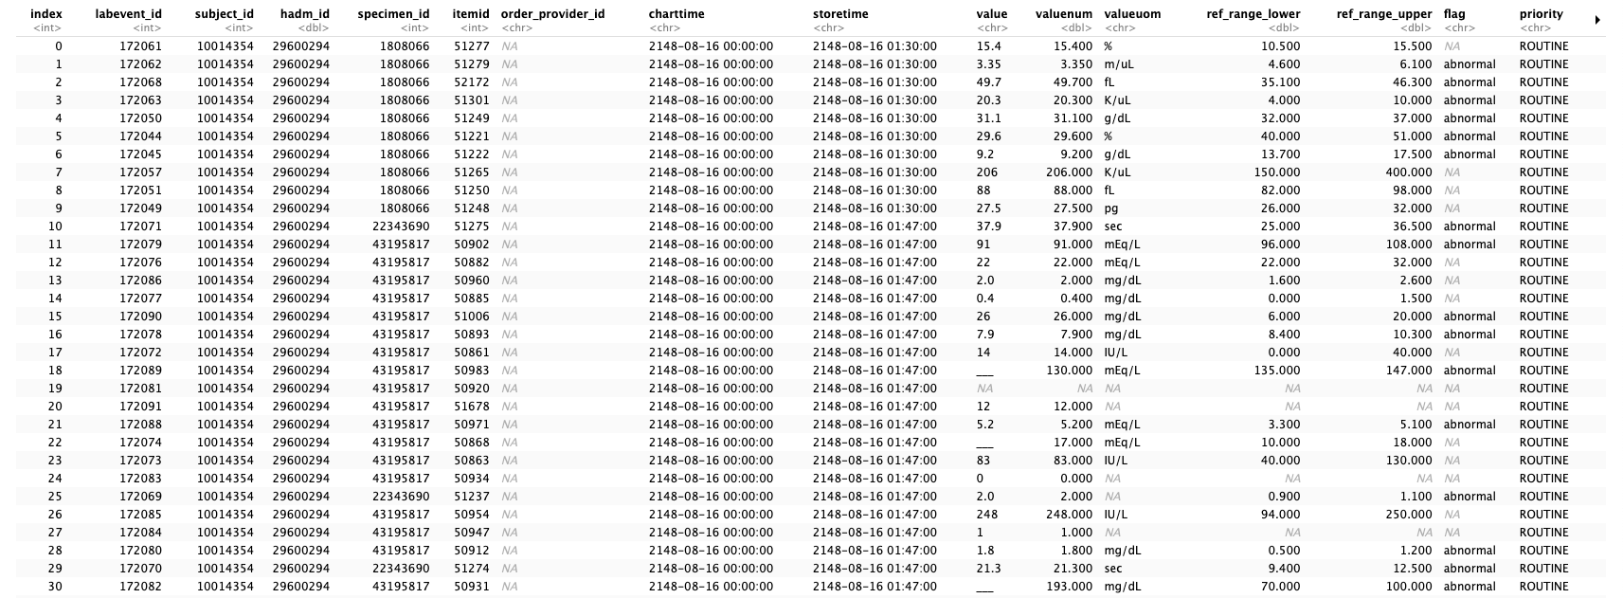
Lab Events Table (labevents)

Slide 21
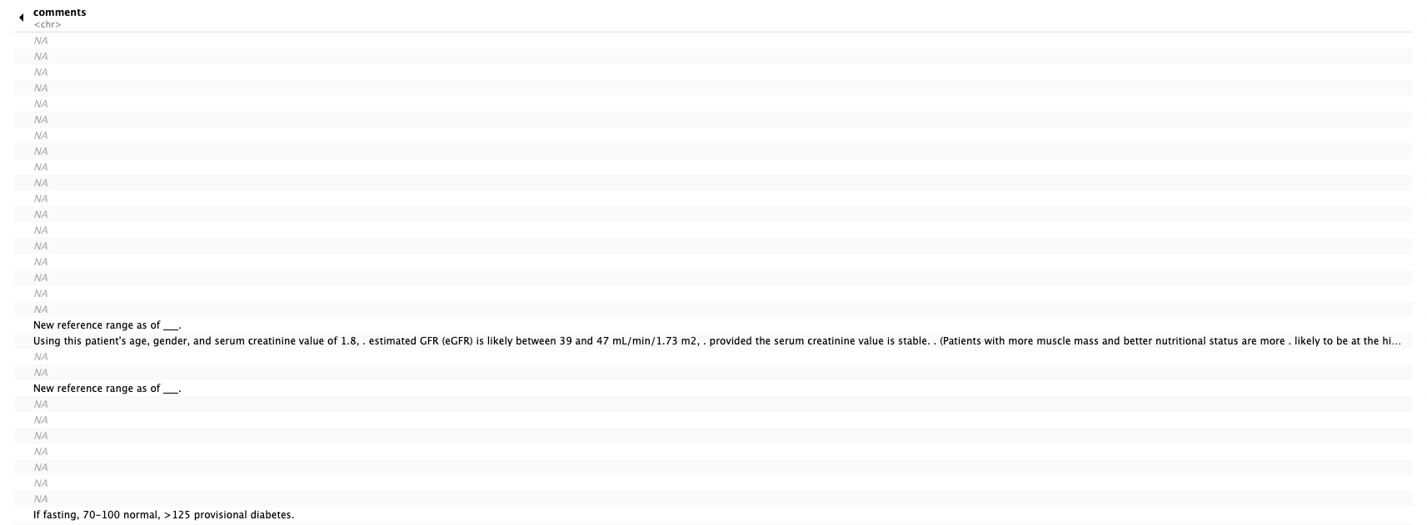
Lab Events Table (labevents) - continued

Slide 22
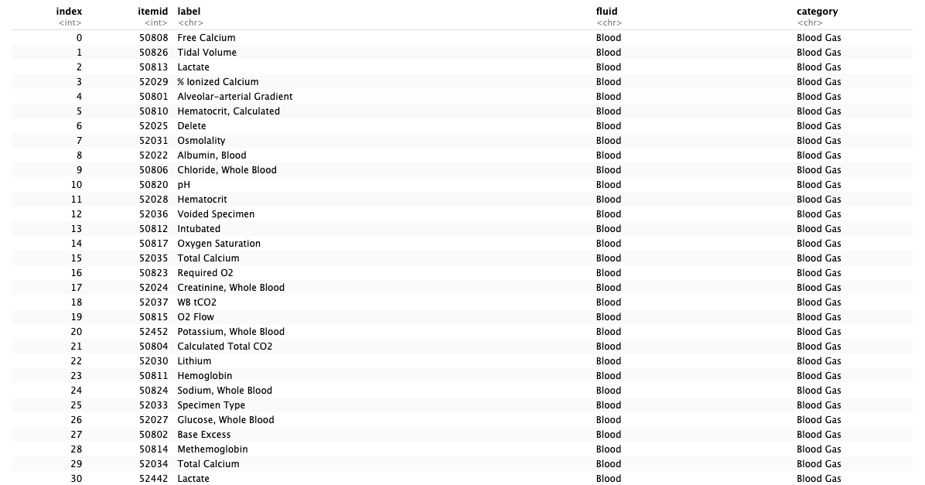
Lab Items (d_labitems)

Slide 23
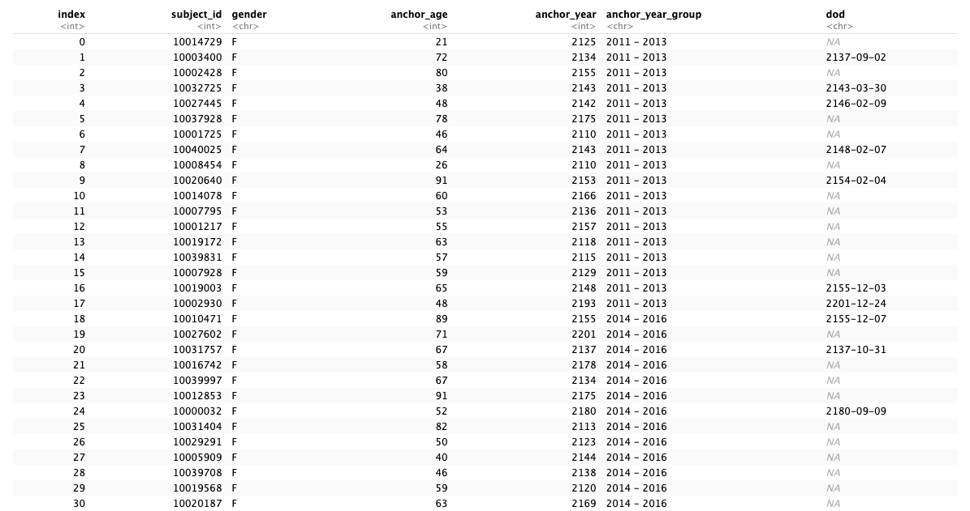
Patients (patients)

Slide 24
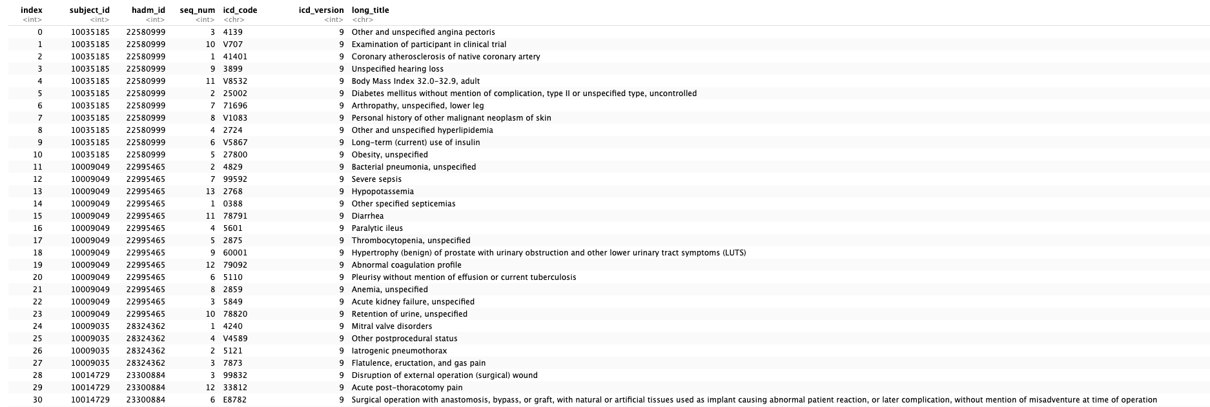
Diagnoses (diagnoses_icd)

Slide 25
Your Turn #3
Label the following tables as fact tables or dimension tables:
-Lab Events
-Lab Items
-Patients
-Diagnoses

Slide 26
Querying Databases

Slide 27
Structured Query Language (SQL)
The standard query language of the relational database
Clauses are chained to create queries:
SELECT clause chooses the columns to return in a query
FROM clause chooses the table(s) from which the columns are returned
WHERE clause specifies inclusion/exclusion criteria for rows
Notes:
https://en.wikipedia.org/wiki/SQL
07 – Using databases

Slide 28
The Lightweight Choice: SQLITE
SQLite is designed to be operated without a separate database management system (i.e. extra software) nor a database administrator
Requires less configuration than many other DB solutions
Stores DB on a single file
Unique approach to access control: access to file determines control (unlike other databases that integrate a separate access - username/password - infrastructure)
Origins of SQLite: https://thenewstack.io/the-origin-story-of-sqlite-the-worlds-most-widely-used-database-software/
Notes:
03 – Databases with R

Slide 29
R SQL Translation
Knowing SQL is not necessary for today’s workshop
R will handle the SQL for us
Learning SQL may be helpful for other applications

Slide 30
Recap
Database Systems include the database (data) and database management systems (software for interaction with the database)
Relational databases are the dominant database form and are composed of related tables (rows and columns)
Fact tables carry the transactions and Dimension tables carry the descriptions.
Structured Query Language (SQL) is the standard language for interacting with relational datbases. SQL statemenes are composed of clauses: SELECT, FROM, WHERE.
Medical Information Mart for Intensive Care (MIMIC) is the relational database we will work with in today’s workshop.

Slide 31
What else?
Notes:
At the end of each lesson we have included a what else section to introduce you to ”what else” you may want to explore and learn about after completing this course.
This includes helpful hints, other functions in the Tidyverse, and exciting packages you may want to check out.

Slide 32
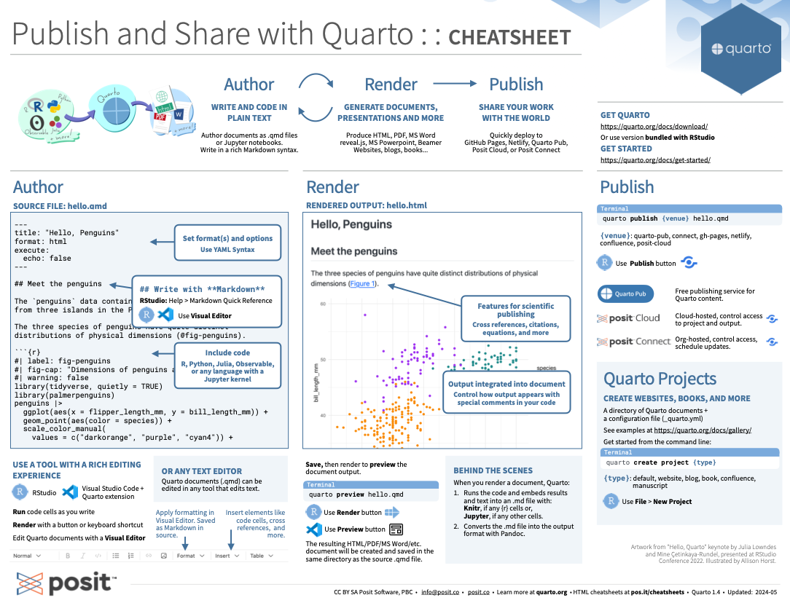
https://posit.co/resources/cheatsheets/
Notes:
General cheat sheet reminder

Slide 33
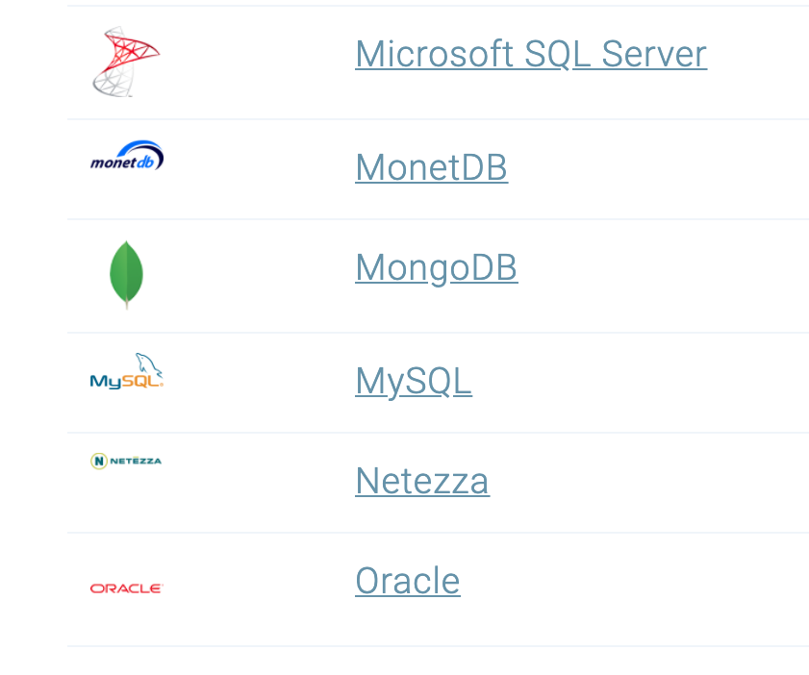
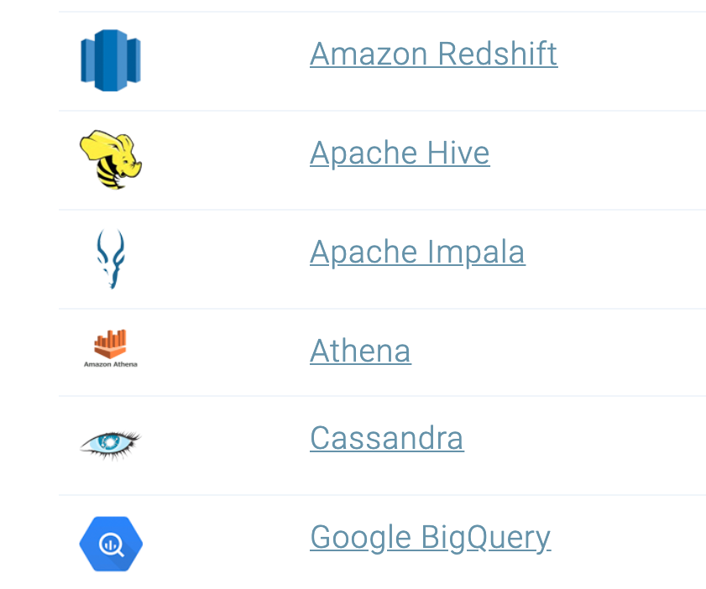
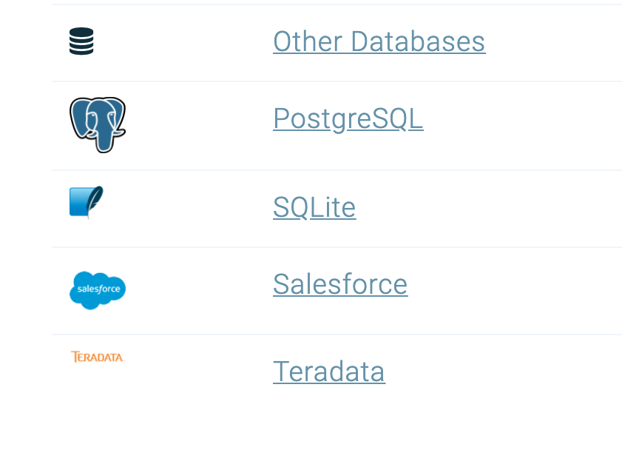
Databases
https://solutions.posit.co/connections/db/databases/
Notes:
You can also connect to a variety of different databases directly in R to source your data.
If you use any of these, you may want to check out the tools to make database connections in R.

